Slide 1
Basic E-Commerce Concepts
CSI 5389 (E-Commerce Technologies)

Slide 2
Outline
Introduction
  Example of an e-commerce store
  Defining the term “Internet commerce”
  Why participating in Internet commerce?
  Key properties of the Internet
  Strategic issues in Internet commerce
  Business issues in Internet commerce
  Technology issues in Internet commerce
The Commerce Value Chain (CVC)
  Introducing the CVC
  Components of the CVC
  Building customer relationships with Internet commerce
  Marketing on the Internet
  Doing business internationally
  The legal environment
CSI 5389 (E-Commerce Technologies)

Slide 3
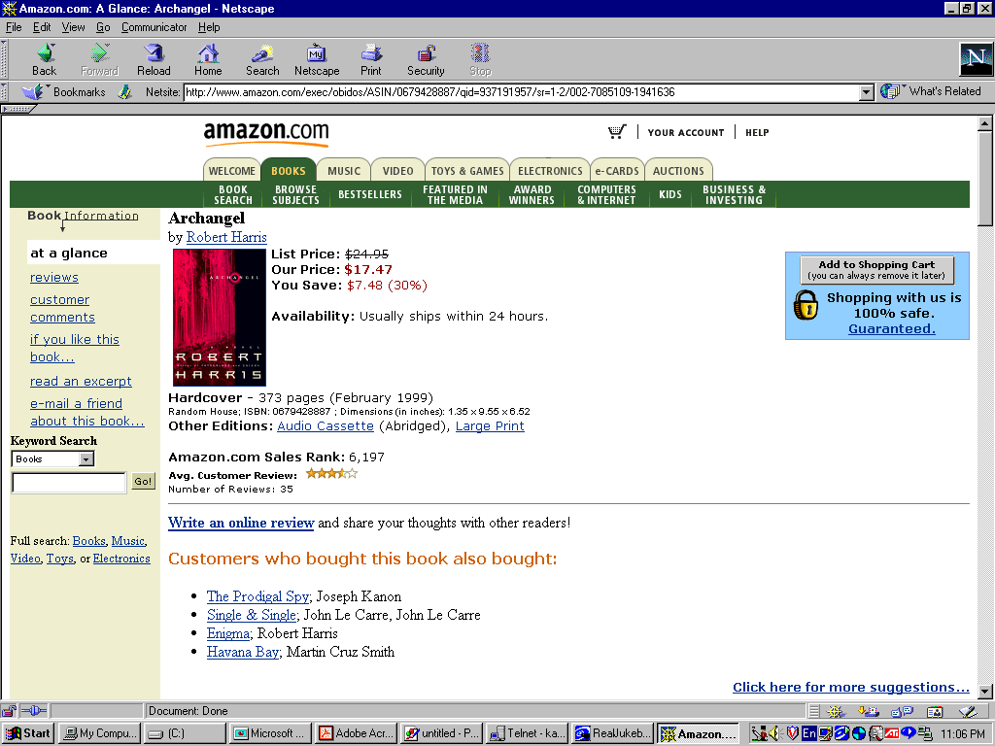
SECURITY
CONTENT
PRESENTATION
Dr. Thomas Tran
CSI 5389 (E-Commerce Technologies)
Notes:
Let’s us look at amazon.com as an example of an e-commerce store
This site shows an item (i.e. a book) on sale with necessary information such as title, author, price, shipping information etc. This is what we call “content presentation” of an e-commerce store
The site also presents “security feature”, which is of course very important to any online purchaser

Slide 4
TRANSACTION
PROCESSING
RECOMMENDER
SYSTEMS
Dr. Thomas Tran
CSI 5389 (E-Commerce Technologies)
Notes:
Amazon.com also has a built-in “recommender system”, which suggests other items for the customer to buy in addition to the presented item
An e-commerce store must have facility to process a transaction, e.g., allowing customers to place items in a shopping cart, to pay for their chosen items, to access their accounts etc.

Slide 5
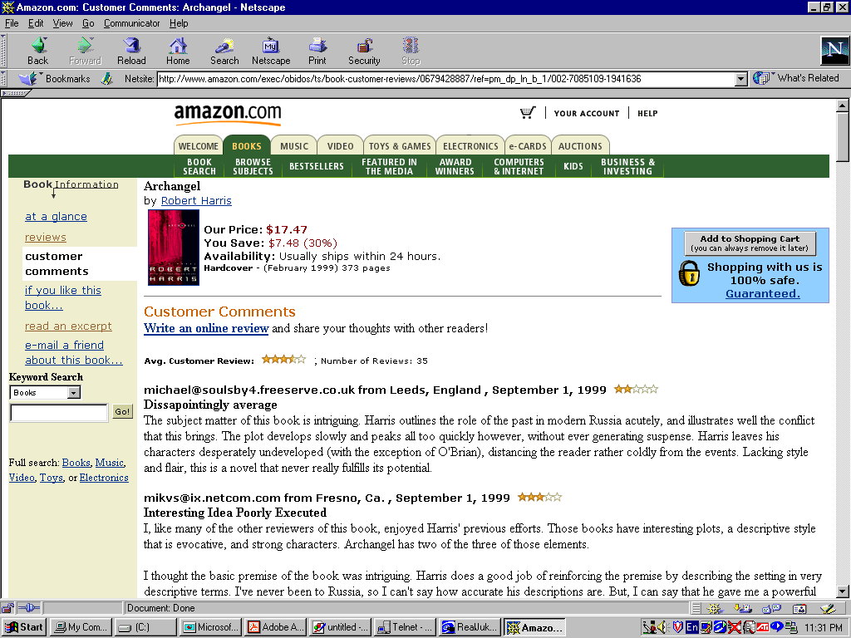
ELECTRONIC
COMMUNITY
Dr. Thomas Tran
CSI 5389 (E-Commerce Technologies)
Notes:
Nowadays, many e-commerce store also establish online communities or forums via which customers can post and exchange their opinions and comments on the store’s products

Slide 6
What do we mean by “Internet Commerce”?
By “Internet commerce”, we mean the use of the global Internet for purchase and sale of goods and services, including service and support after the sale.
Internet commerce is one type of the more general electronic commerce.
  The best-known idea in electronic commerce has been Electronic Data Interchange (EDI), originally created for linking organizations with their partners and suppliers.
  EDI and the Internet do not exclude one another: EDI, which specifies certain kinds of messages, can be used with the Internet, which is a way of moving data.
  Internet commerce transcends many restrictions of EDI: companies can communicate over a shared public network, rather than building specialized networks or contracting for expensive Value-Added Network (VAN) services.
  EDI formats are being replaced by Extensible Markup Language (XML) that are more general, more extensible, and easier to use.
  In this course, we use the terms “e-commerce” and “Internet commerce” interchangeably.
CSI 5389 (E-Commerce Technologies)

Slide 7
Why Internet Commerce?
The ability to reach new customers and create more intimate relationships with all customers
Dramatic cost reduction for distribution and customer service
CSI 5389 (E-Commerce Technologies)

Slide 8
Access to a Global Market
Every business on the Internet has a global presence.
The Internet makes it possible to work effectively and efficiently with customers, partners, and suppliers around the world
  Worldwide, high-bandwidth communications
  Essentially the same cost of communications (whether the parties are down the street or halfway around the world)
  Technologies allow businesses to know more about their customers
CSI 5389 (E-Commerce Technologies)

Slide 9
Great Cost Reduction in Distribution and Customer Service
The ability to deliver information to customers in a low cost manner becomes an important part of making the sale.
Sending a printed brochure through postal service costs several dollars for each recipient. Sending the equivalent in e-mail costs nearly zero per recipient.
The Internet makes it possible to provide even more information at lower cost, and to have that information be always accurate, up-to-date, and searchable.
The same ideas hold for selling information products online.
CSI 5389 (E-Commerce Technologies)

Slide 10
Key Properties of the Internet
The Internet is interoperable
  A computer is connected to the Internet if it can communicate with any other computer connected to the Internet.
The Internet is global
  The Internet structure is based on standardized and universal connectivity.
The Web makes it easy
  The WWW has made high functional multimedia content easily available to users worldwide.
The costs of the network are shared across multiple applications and borne by the end users.
  Businesses and consumers pay for their own connections and then are free to use the network for their purposes.
CSI 5389 (E-Commerce Technologies)

Slide 11
Strategic Issues
Concentration versus Empowerment
  The Internet allows direct access from businesses to consumers and greatly reduces the costs associated with distribution.
  This could lead to a great concentration of suppliers, or to the opposite: the creation of tens of thousands of small and medium-sized suppliers.
New Competitive Challenges
  The Internet can bring formerly disjoint businesses into direct competition.
  Costs and efficiencies must become competitive worldwide.
CSI 5389 (E-Commerce Technologies)

Slide 12
Business Issues in Internet Commerce
Internet commerce is about business: using the network effectively to achieve business goals.
  Current technology provides tools for reaching business goals.
  If we do not have a clear idea of our business goals in using the network, then technology cannot help us to achieve them.
CSI 5389 (E-Commerce Technologies)

Slide 13
Business Issues (cont.)
Business goals can also be changed to take advantage of current technology.
  Technology often allows new kinds of operations that were previously too expensive.
  For example, it is entirely appropriate to choose a new focus on closer customer relationships, using the Internet to communicate with customers.
  Without the network, such a goal might have been too expensive or difficult to achieve.
CSI 5389 (E-Commerce Technologies)

Slide 14
Business Issues (cont.)
Business issues for Internet commerce cross the entire range of business activities:
  How does Internet commerce fit with our strategy? Should we change our strategy?
  What does this mean to our competitive situation?
  Do we expect return in the short term, or is this a long-term investment?
  How much will it cost? What do we expect to accomplish?
  How will we measure the success?
  How does this affect our sales channels, our partners, and our suppliers?
CSI 5389 (E-Commerce Technologies)
Notes:
Business activities range from attracting customers to fulfilling their orders, from sales to accounting and after-sale customer support.
Setting up a web site may seem easy: creating a few HTML pages, hosting on a local Internet service provider, and handling some emails, etc.
Let’s compare that simple e-commerce system with a much more complicated one that allows real-time catalog updates, dynamically maintains user profiles, takes payment in multiple ways, links to inventory and fulfillment systems, and provides customer support.
One approach is to allow such functions to add in an initial web site gradually over time. The second approach is to plan for an evolving website, learning from each step and modifying the plan as appropriate.
Although a company may succeed with the first approach, it probably will not have an accurate idea of what it costs and how to measure the success.
The second approach may not provide an instant gratification of getting a web site running as soon as possible, but it does a company to measure the cost and to expect what to accomplish.

Slide 15
Technology Issues in Internet Commerce
There are two key technology issues:
  Which technology to use?
  How to deal with the fast pace of technological change?
First issue: How to apply Internet technology to business problems.
  E-commerce applications bring together many technologies: the Web, databases, high-speed networking, cryptographic algorithms, multimedia, etc.
  Putting them together to form a secure, high-performance, integrated e-commerce system can be challenging.
CSI 5389 (E-Commerce Technologies)

Slide 16
Technology Issues (cont.)
Second issue: how to deal with the fast pace of technological change?
  Any commerce system must be prepared to accommodate and incorporate new technologies as they become available.
  The key to such adaptability is a coherent system architecture that clearly lays out what is to be accomplished and why.
  By focusing on the fundamental principles we can adopt new technologies that help us to achieve our goals, while avoiding new technologies that may seem exciting but do not really fit in with our goals or the system.
CSI 5389 (E-Commerce Technologies)

Slide 17
The Commerce Value Chain (CVC)
1. Attract customers
  Advertising, marketing: get and keep customer interest
2. Interact with customers
  Catalog, sales: turn customer’s interest into order
3. Act on customer instructions
  Order management: capture customer’s order , process payment and fulfillment of order
4. React to customer requests
  Customer service: provide order tracking and technical support
CSI 5389 (E-Commerce Technologies)

Slide 18
The CVC (cont.)
Looking at the value chain for a business helps to define areas of focus: what the business is best at, or where the most emphasis should be placed.
Consider 2 bookstores: one that emphasizes on large selection, and one that emphasizes personal service.
  A focus on large selection should require a comprehensive database, and tools for searching for books in different ways, etc.
  A focus on personalized service may result in forums for discussions among customers, interaction between customers and employees, etc.
CSI 5389 (E-Commerce Technologies)

Slide 19
The CVC (cont.)
Thinking carefully about the value chain helps to select the most important ideas from a long list of possible activities in Internet commerce.
  The large bookstore may want to provide all of the services of the smaller one, but if it does not focus on its core ability (i.e., providing easy access to a large number of books), it is much less likely to succeed.
It is important to use the Internet to reinforce the core strategy of the business, rather than trying to do everything.
It is also possible to work with partners to fill out the value chain, so that each link is strong.
CSI 5389 (E-Commerce Technologies)

Slide 20
Components of the CVC
Attract Customers
  Making an impression on customers and drawing them into the information about products and services for sale.
  Achieved by paid advertising on Web sites, e-mail, television, print, or other forms of advertising and marketing.
Interact with Customers
  Turning customer’s interest into orders.
  Content-oriented phase, including catalog, publications, or other information distributed by WWW, e-mail, or CDs etc.
  Content may be static or dynamic.
CSI 5389 (E-Commerce Technologies)

Slide 21
Components of the CVC:
Interact with Customers (cont.)
Static content:
  Prepared pages that are sent to a customer on request.
  Must be re-created whenever the information changes.
Dynamic content:
  Generated at the time of the request.
  Taken from information sources such as databases.
  Used when the content changes frequently or when the natural storage medium for the information is a database.
CSI 5389 (E-Commerce Technologies)

Slide 22
Components of the CVC:
Act on Customer Instructions
When a customer makes a purchase, there must be ways to capture the order, to process payment, to handle fulfillment, and other aspects of order management.
Order processing:
  Includes the ability to group several items together for later purchase (e.g., shopping cart).
  Allows the customer to add items, remove items, change the quantities and so on.
  Computes additional charges (shipping costs, taxes).
  Presents the customer with an itemized order form including all charges.
CSI 5389 (E-Commerce Technologies)

Slide 23
Components of the CVC:
Act on Customer Instructions (cont.)
Payment processing:
  Once the order is final, the buyer can pay for it.
  There are several payment methods (e.g., credit cards, purchase orders, etc.), one of which must be agreed up on by the buyer and the seller.
  The seller must be careful about imposing requirements on the buyer: If the buyer must have a special software package to handle payment, the population of buyers would be much smaller.
  Completing this process does not necessarily mean that funds have been transferred into the seller’s bank account: Some payment instruments extend credit to buyers to make the actual payment later.
CSI 5389 (E-Commerce Technologies)

Slide 24
Components of the CVC:
Act on Customer Instructions (cont.)
Fulfillment:
  If the ordered item is a physical good then the order is forwarded to a traditional fulfillment system (e.g., someone picks up the item, packs it, and ships it.)
  Method for forwarding the order could simply be printing out or faxing the order form, or could use a more complicated interface to another computer system such as EDI.
  If the ordered item is a digital good then there is a wide variety of online delivery (e.g., software delivered online, access to a database for a period of time, etc.)
  Delivering digital goods can be quite complex as we shall discuss later
CSI 5389 (E-Commerce Technologies)

Slide 25
Components of the CVC:
React to Customer Inquiries
After a sale has been completed, the customer may have some questions or may require some service.
Some questions must be answered by a person, some can be answered with an appropriate information system.
A transaction system that keeps track of all of a customer’s purchases can generate a summary statement.
A more complicated example: How the system handle a failure when delivering a digital good? (e.g., a network error causes the download of the digital good to fail.)
Customer needs proof of purchase (receipt) which is accepted by the fulfillment server for another download.
Designing systems that eliminate the needs for customers to ask questions (e.g. the use of receipt above).
CSI 5389 (E-Commerce Technologies)

Slide 26
Building Customer Relationships with Internet Commerce
Good relationships with customers are one sign of a successful business.
It is always easier to keep a customer than to find a new one.
From the Internet commerce perspective, we consider 2 issues:
  Improving the existing service for customers.
  Finding ways to apply new technologies to deliver better or different service to customers.
One of the best ways to build strong relationships is through communication.
  Customers want to know about vendors and products.
  The Internet enables vendors to communicate with customers in ways that are efficient for both parties.
This communication capability can be used to provide new services (e.g., up-to-date status information about an order or service).
CSI 5389 (E-Commerce Technologies)

Slide 27
Marketing on the Internet: The Internet Is Different from Other Media
One of the most important properties of the Internet is that everyone can be a publisher, reaching the same worldwide audiences.
This property defines how the Internet is different from other media.
  The telephone allows one to call one person at a time, limiting in time the number of people one can reach, and requiring both people to be available at the same time.
  Traditional mass media (newspapers, television etc.) can reach large audiences, but is limited by resources and by the investment required to create and distribute the medium.
CSI 5389 (E-Commerce Technologies)

Slide 28
Marketing on the Internet: The Internet Is Different from Other Media (cont.)
These limitations do not apply to the Internet.
  Using tools such as e-mail or the Web, the sender can reach large number of receivers. Senders and receivers do not need to be available at the same time.
Implications:
  Small merchants can reach customers on the Internet very effectively.
  Communication technology combined with databases of customer information makes it possible to reach customers as individuals.
CSI 5389 (E-Commerce Technologies)

Slide 29
Marketing on the Internet: Basic Questions
Technology is no substitute for a good understanding of the basic principles of marketing.
Basic marketing questions:
  Who is the customer?
  What does the customer need?
  What does the customer want?
  What message do you want the customer to remember?
  How can information be presented to the customer effectively?
CSI 5389 (E-Commerce Technologies)

Slide 30
Marketing on the Internet:
Understanding the Demographics
The demographics are changing rapidly. What is true today might not be true tomorrow, so it is important to watch the trends and how they might affect the market plan. Increasingly, it is true that everyone is on the Internet.
Focus on the demographics of target customers, rather than searching Internet demographics for interesting potential customers.
CSI 5389 (E-Commerce Technologies)

Slide 31
Marketing on the Internet:
One-to-One Marketing
The Internet is an ideal medium for one-to-one marketing in which a business can tailor the messages to individual customers based on their known interests, likes, dislikes, and buying histories.
A Web site can identify customers before they browse a catalog and then use those identities to customize the presentation.
The customization can take many forms (e.g., selecting which items to display, providing targeted special offers, inserting advertisements of likely interest, etc.).
Even when customers are anonymous, their behavior may provide some clues that are useful in tailoring a message.
CSI 5389 (E-Commerce Technologies)

Slide 32
Marketing on the Internet: Advertising
Advertising on the Internet takes many forms.
One of the simplest is a Web site describing products or services for sale.
Just having a Web site provides no guarantee that customers will visit, so ads are placed in many other locations (e.g., other Web sites, search engines etc.).
Demographics issues: A good site for advertising need only be popular with potential customers, not necessarily popular with the Internet at large.
Advertising on the Internet should be done with care: Sending unsolicited advertising to Internet mailing lists (spamming) is widely unacceptable.
CSI 5389 (E-Commerce Technologies)

Slide 33
Doing Business Internationally
The Internet brings people and organizations together around the world. This gives any online business the potential to reach customers around the world and to become a true international business.
International business issues are not so simple:
  Problems of currency conversion, presenting messages in several languages, import/export laws and tariffs, etc.
Let us discuss some important issues in creating an effective international online business.
CSI 5389 (E-Commerce Technologies)

Slide 34
Doing Business Internationally:
International Software
The most important aspect of software for use in different countries is that the presentation (such as the user interface) can be adapted to local conventions.
In many cases, this means translating all the displayed information into local languages.
  The software must be able to display whatever character set is required.
  The software must be capable of using the translated messages.
  The software must be able to handle the local currency.
CSI 5389 (E-Commerce Technologies)

Slide 35
Doing Business Internationally:
International Content
Aside the translation of text, true internationalization of content requires extensive work. Here are some issues:
References to local geographies, people, and news events do not translate well.
Humor does not translate well.
Words (particularly product names) may have very different interpretations in different countries.
Trademarks work differently in different countries.
Colors (used in corporate color schemes and logos) make different impressions in different cultures.
These issues are well understood by multinational companies, but represent serious problems for smaller companies that want a global presence.
CSI 5389 (E-Commerce Technologies)

Slide 36
Doing Business Internationally: Privacy
Many countries, especially in Europe, have strict laws governing the collection and use of personal information about consumers.
Any online business operating in such countries must be sure that its systems comply with the local law.
It is a good business practice to inform customers of what kinds of data are being collected, and how the data is being used.
Most consumers know very little about issues of privacy online, so they may have unrealistic expectations.
By explaining the relevant privacy issues up front, a business can avoid later problems if customers feel their privacy has been compromised.
CSI 5389 (E-Commerce Technologies)

Slide 37
The Legal Environment
The rapid development of computer and communication technology has presented many challenges for legal systems.
  The ability to gather, correlate, and search large volumes of information about individuals and organizations raises questions of privacy.
Since business operates in a legal environment, we must take it into account when developing strategies for Internet commerce.
Legal systems will not change overnight, but they may certainly adapt to new requirements that arise from Internet commerce.
Let us look at some important legal issues in planning systems for Internet commerce.
CSI 5389 (E-Commerce Technologies)

Slide 38
The Legal Environment: Taxation
Since businesses are legally obligated to pay taxes, it is important for software systems to compute taxes and keep the necessary records.
Computing taxes can be very complicated:
  So many factors: the type of good or service for sale, the parties involved, the locations of the business, the location of the buyer, etc.
  Rules for taxation differ from country to country.
It is important for online businesses to be alert for changes in tax laws that may affect their operations.
CSI 5389 (E-Commerce Technologies)

Slide 39
The Legal Environment: Digital Signatures
Electronic documents cannot be signed by hand, but cryptography has given us a tool to accomplish the same purpose: digital signatures.
A digital signature on an electronic document can be used in many respects just as a handwritten signature is used.
  E.g., An electronic contract can be digitally signed by the parties, just as paper contracts are signed by hand.
Several countries have passed legislation that recognizes digital signatures.
CSI 5389 (E-Commerce Technologies)

Slide 40
The Legal Environment:
Regulation of Cryptography
Cryptography encompasses encrypting data for privacy, providing reliable means of verifying identities, recording digital signatures, and ensuring that there has been no tampering with messages and documents.
In some cases, the use or sale of cryptographic technology is regulated. The regulations differ from country to country.
  The U.S. used to restrict the export of strong cryptography in mass-market software. Today, such applications must be licensed for export.
Regulation of cryptography may affect the security of the Internet commerce systems.
  If the customer’s system has weak security, then the overall security of the transaction is also weak.
The lack of uniformity means that it is harder to build confidence in the security of the global Internet commerce infrastructure.
CSI 5389 (E-Commerce Technologies)

Slide 41
References
G. Winfield Treese and Lawrence C. Stewart. Designing Systems for Internet Commerce (2nd edition): Chapters 1 & 2. Addison Wesley.
Dr. Thomas Tran Slides
CSI 5389 (E-Commerce Technologies)

